Slide 1





Team Worf
Project Activity #5
Presentation

Slide 2
Team members
Alok Paranjape
Khelan Natha
Vandan Chauhan

Slide 3



Project Idea Refresher
ShareNote, a Web app that lets users easily create and share notes with their peers.
All members contributed to the group activities relating to initiating and planning. Later, we divided the construction and documentation activities amongst members more individually.

Slide 4
Project Planning Phase

Slide 5
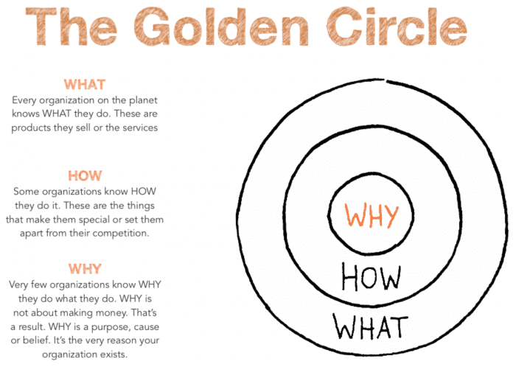
But Why, and other W’s…
Why?
We think learning should be an efficient and collaborative experience, instead of an isolated personal obligation.
How?
By making it easier for students to take and share notes.
What?
A note taking web app, that can be used to share notes with peers, and access the shared notes of other users.
Who?
The target user for this app is students. However, it can be used by educators and tutors to share notes amongst their students.

Slide 6
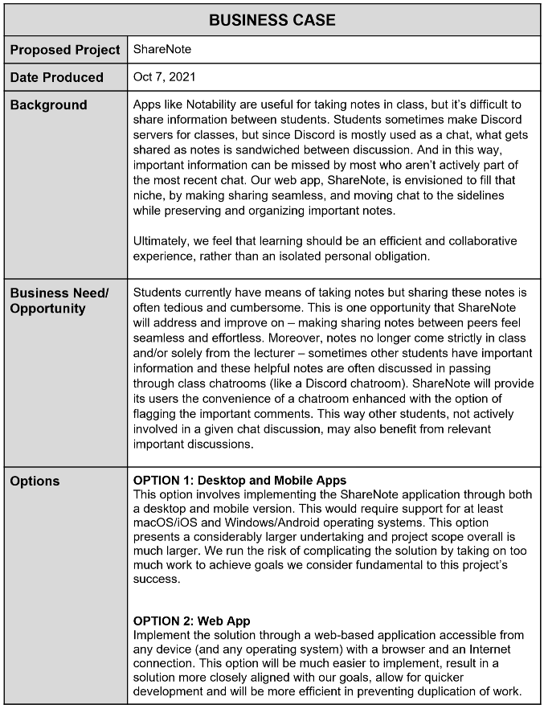
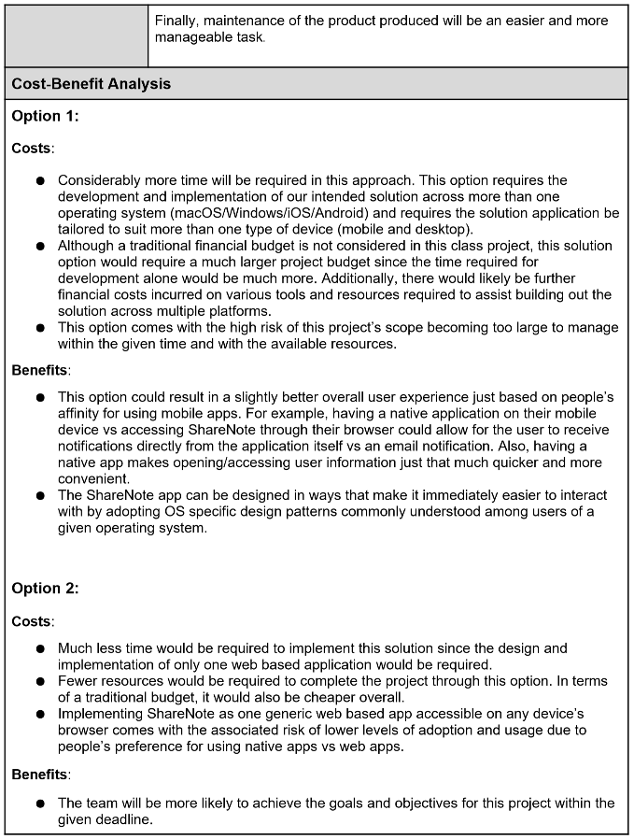
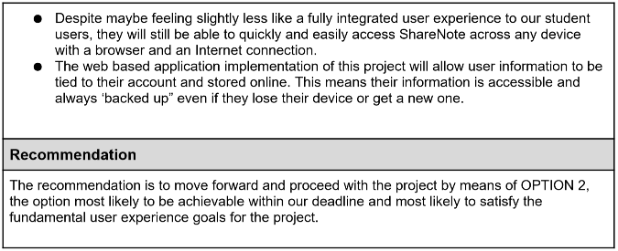
Business Case
Key Takeaways:
We saw an opportunity to create a web app that makes the process of taking, and then sharing notes with peers easier.
Considering our time and skill set constraints, we determined a web based app to be the best way to move forward.

Slide 7
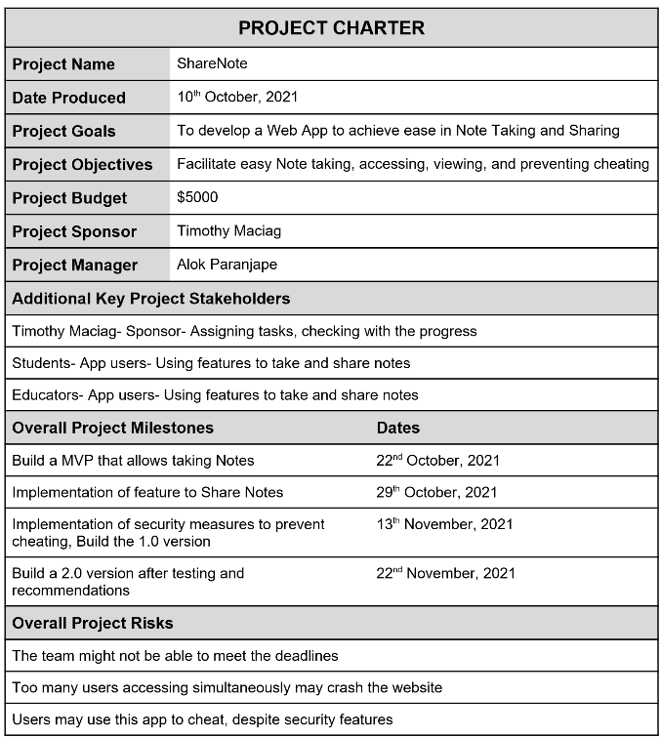
Project Charter
Key Takeaways:
Our milestones weren’t aligned with the progress of project activities and class material, making them hard to follow.
Not making the deadlines was a serious risk, we should have taken more steps to account for this.
Risk of not being able to handle many users, and the risk of users cheating were not encountered, due to a lack of testing.

Slide 8
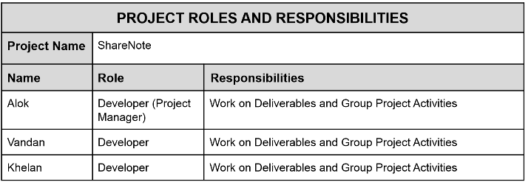
Roles and Responsibilities
Key Takeaways:
Initial roles were quite general, everyone's the same
Was naive to think everyone would work on everything. Sounds ideal, but not how it goes.
As the activities progressed people got more specialized.

Slide 9
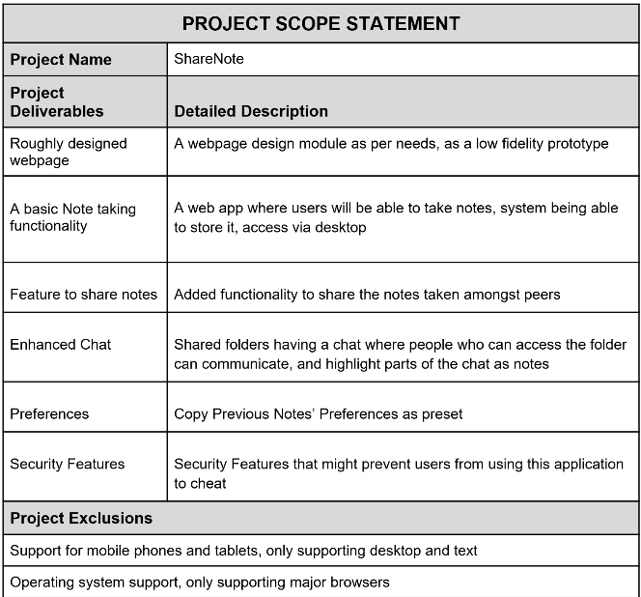
Project Scope Statement
Key Takeaways:
The scope was defined with good separation of concerns, but was idealized in the planning phase and proved to be too large as project progressed.
Some of the scope was attainable, but more should have been in the exclusions.
Defining the scope in relation to a true MVP from the outset would have helped limit scope.

Slide 10
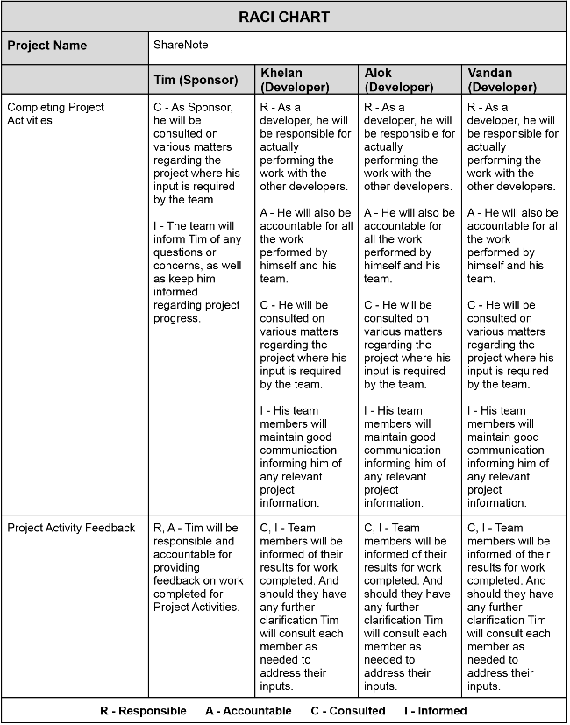
RACI Chart
Key Takeaways:
All members were Consulted and Informed with every aspect of the project, which was great for communication.
In retrospect, breaking down the overall project activities into more specific chunks, would have been better.
This is all easier to say now looking back, compared to trying to come up with specialized roles right at the beginning.

Slide 11
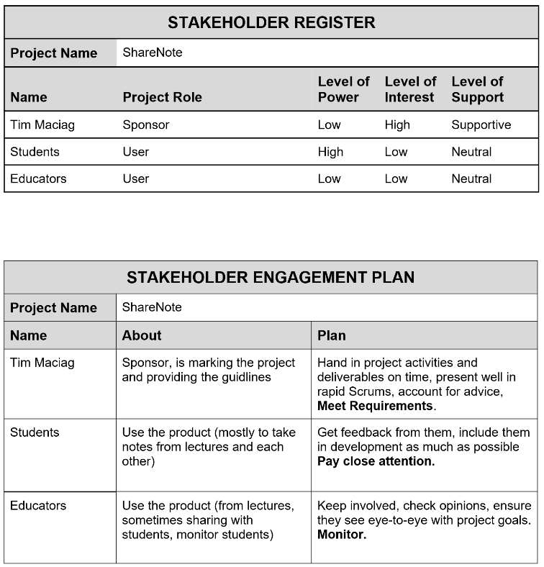
Stakeholder Engagement Plan
Key Takeaways:
Again, looking back we feel that coming up with as few Stakeholders as is required by a true MVP would be more efficient.
Educators fall outside the scope of the intended user for our later defined MVP - we simply had no use for an engagement plan regarding Educators.
We did follow the plan for the other stakeholders.

Slide 12
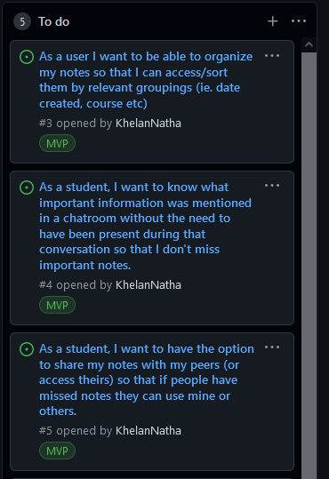
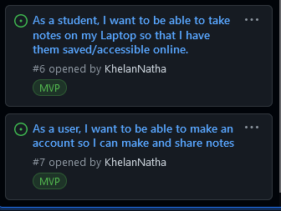
Initial GitHub/Kanban
Key Takeaways:
Initially we had put up several requirements, in the format of user stories to our Github Kanban w MVP board.
Those were the things that in our opinion, were achievable at that time.

Slide 13
Rationalized Initial MVP:
As a user, I want to be able to:
organize notes, and sort them by various filters.
see important flagged notes from chat discussions.
share my notes with peers.
save and access my notes online.
create an account for all my notes.

Slide 14
Software Design Phase

Slide 15
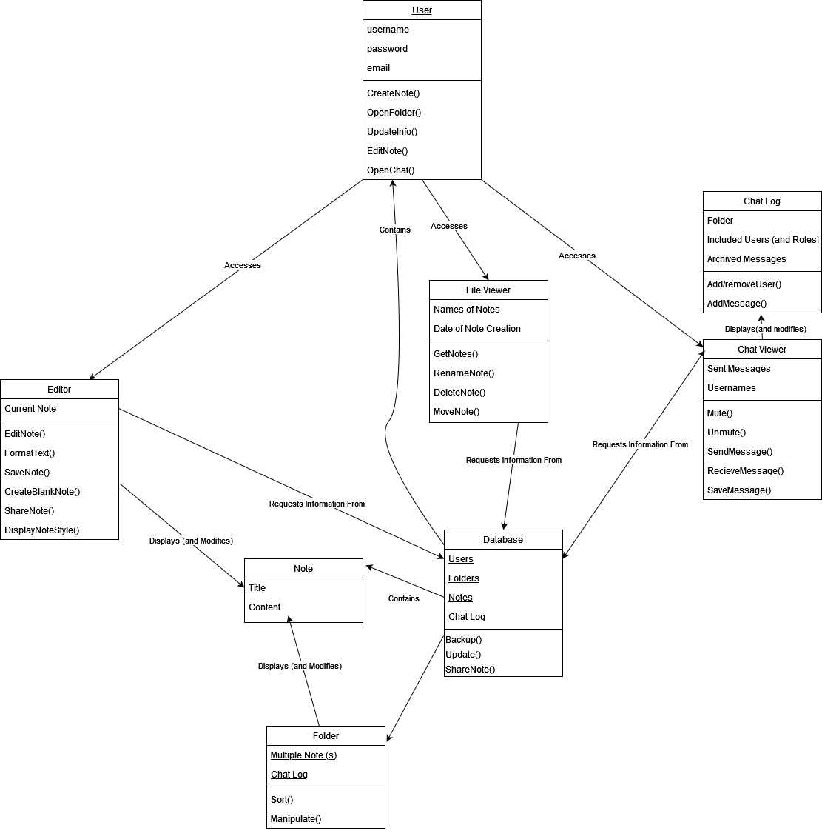
Class Diagram
Key Takeaways:
These diagrams don’t fully map to implementation.
Have functions unnecessary for an MVP.
Overall structure still matches implementation, and intended MVC architecture.

Slide 16
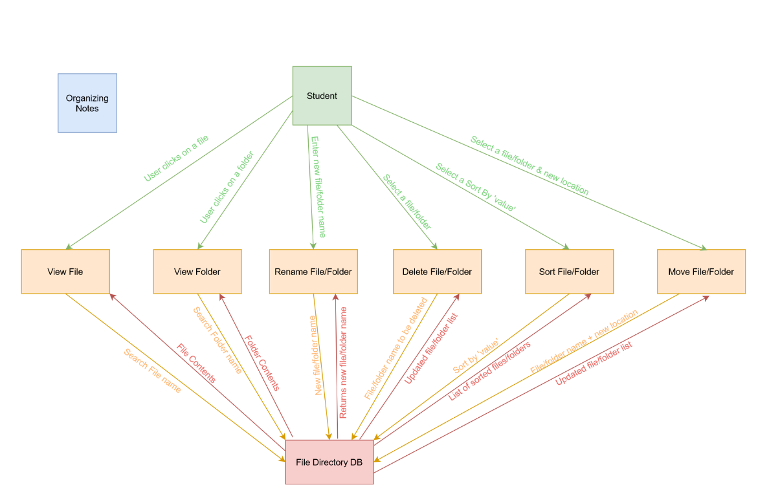
Data Flow Diagram
Key Takeaways:
The overall structure is good, but it doesn’t fully line up with implementation.
Was helpful as general guidelines on which to base the implementation.

Slide 17
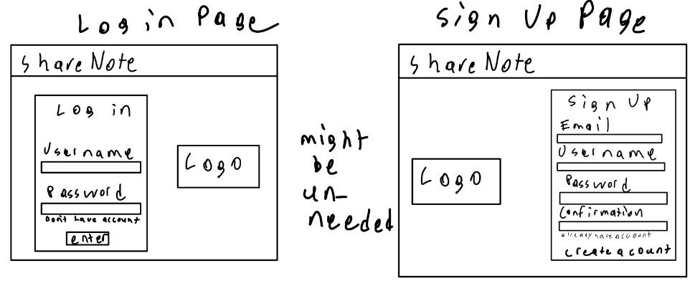
Lofi Sketches - Log In & Sign Up

Slide 18
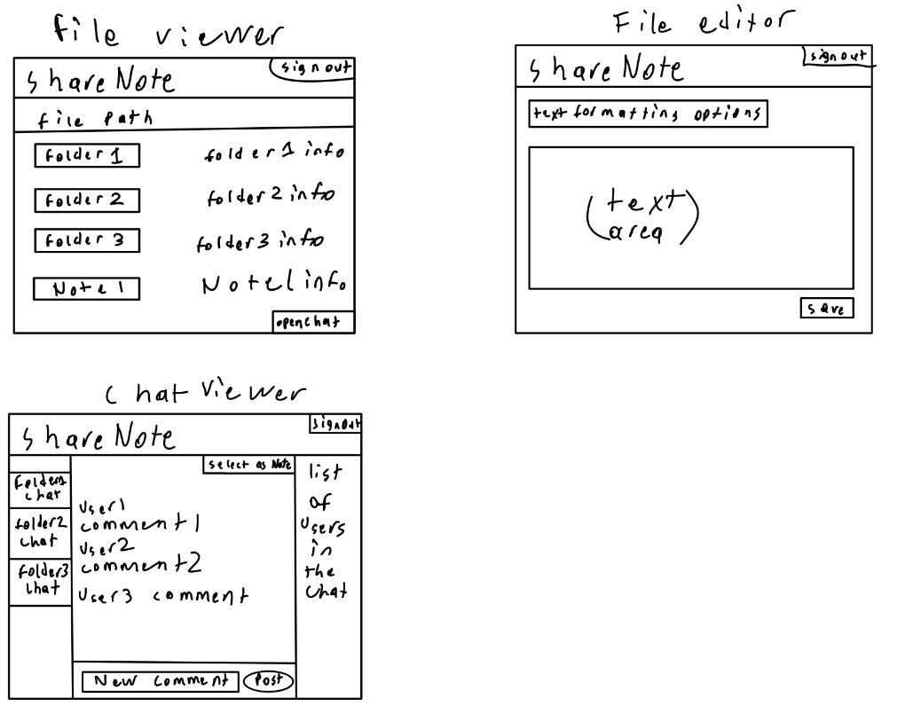
Lofi Sketches - File Viewer, File Editor & Chat Box
Key Takeaways:
It was good to keep these quick and simple. They’re focused on functionality vs aesthetics - in light of our MVP.

Slide 19
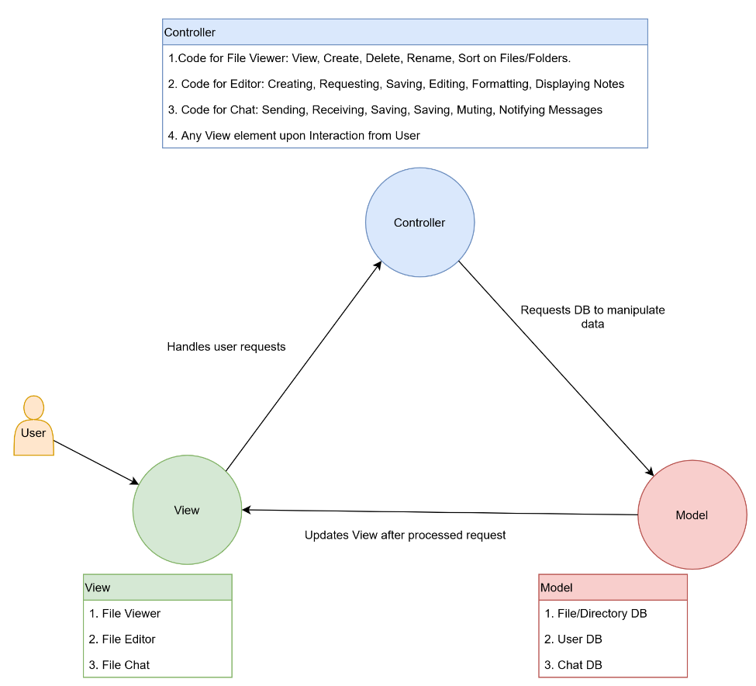
MVC Diagram
Key Takeaways:
Developing the underlying architecture was helpful in facilitating the web app’s implementation.
The separation of concerns seen here in Model, View, Controller is reflected in the code.

Slide 20
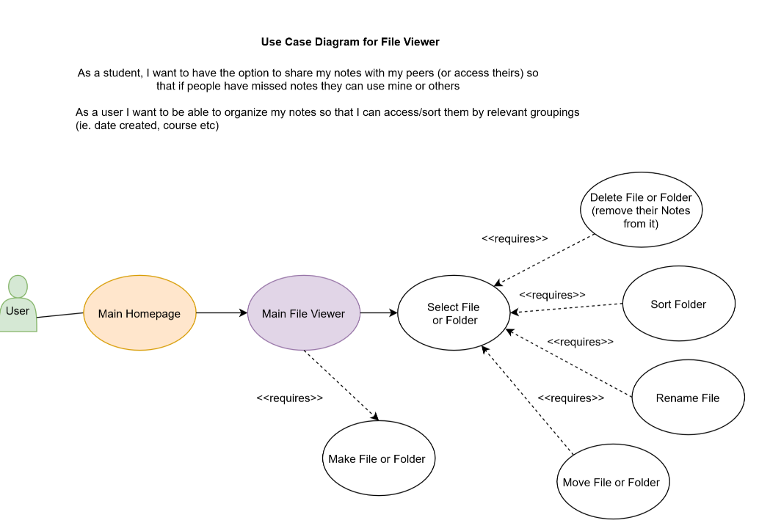
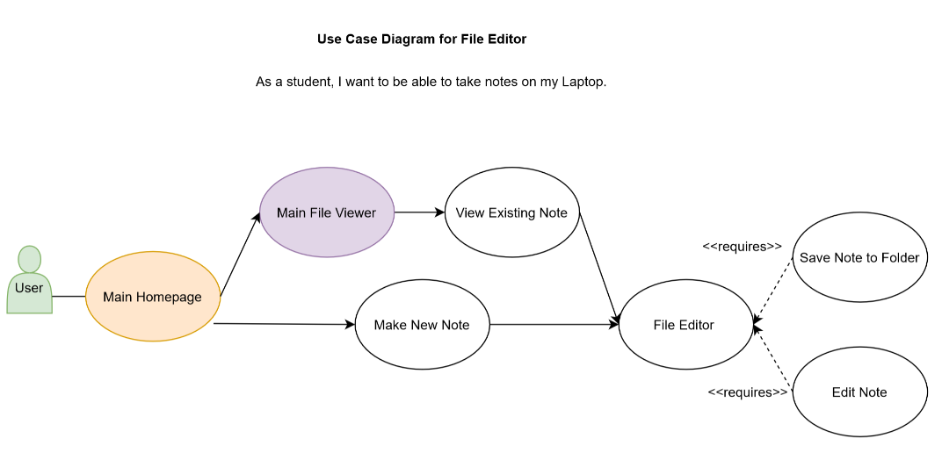
Use Case Diagrams
Key Takeaways:
Initially we thought this would be a good way to envision the overall site structure and interactions.
Actual implementation proved to be mostly different.
Our inexperience with implementing web apps led to this misalignment.

Slide 21
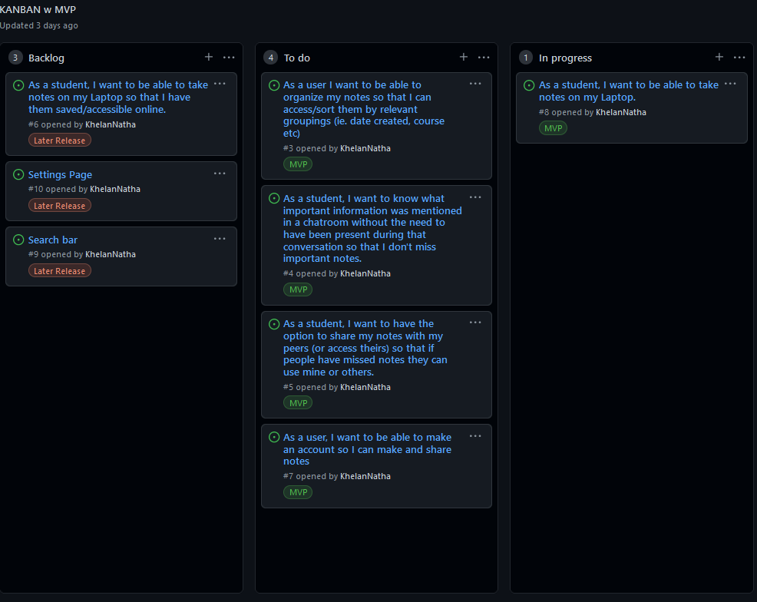
Updated Kanban
Key Takeaways:
We realized some things were unnecessary.
We labelled them ‘Later Release’ and moved them out of our ‘To Do’ column into a ‘Backlog’ column
This helped to refine and focus on our MVP.

Slide 22
Rationalized MVP
Signing Up/Logging In, Making Notes, Sharing Notes -> Necessary
Moved Organizing Notes to the Backlog, because technically it isn’t necessary for creating and sharing notes.
Looking back, we’ve learned that the user stories should have been more specific, and broken into smaller parts. This way each story would encompass fewer functions in the actual implementation.

Slide 23
Changes caused by commentary
We received several feedbacks, from Tim and from the people who observed our project as a part of their activity.
One was similar in almost all of them, unclear roles. However as we mentioned, we had defined clear roles as the execution phase begun.
The rigidity of milestones was also not a matter of concern as we ended up learning those things far later than we thought.
For all the concerns regarding the diagrams, we had mentioned in the respective activity that we had designed the diagrams in a way that we as a team would understand.

Slide 24
MVP Demo
What makes it an MVP?
This release is useful to our target user group since it lets students take notes and share them.

Slide 25
What is the team happy with?
We have produced an MVP allowing users to sign up/login, create folders, save their notes and share them.
These all constitute the basic functionality outlined by our MVP in the latest revision.

Slide 26
What does the team think could potentially be better (if anything)?
Adding some of the features from the backlog
Error testing
Making the UI more readable
Making the variable names more consistent.

Slide 27
Does what the team envisions for a next MVP still jive well?
For the most part, yes, the existing code could be extended to include those features.

Slide 28

Link to local version of web app:

Slide 29
Team Reflection

Slide 30
Q: How did you feel about this project? Do you think your team was successful? What did you like about the project? What did you dislike about the project?
A: We felt this project was quite helpful for learning about project planning and implementation. We got to learn about team coordination. As a team we think we were moderately successful overall. We enjoyed working as a team. One aspect we weren’t too fond of was how we are expected to make judgement calls about how best to handle the project, but without experience you end up making costly mistakes leaving you in a time crunch. But we chalked this up to being part of the learning experience.

Slide 31
Q: What did your team feel most proud of throughout the entire project experience?
A: Despite our inexperience and the difficulties we surmounted, what we did was a huge achievement.

Slide 32
Q: What did you learn about yourself as you collaborated and worked on this project (individually and as a team)?
A:
Khelan - learned that it will take practice and experience to get good at doing projects.
Alok - learned that it’s better to try something, than to give up. Vandan - learned that there may be issues, but always do your bit and contribute as much as we can.
As a group we learned that it’s better for people to specialize rather than everyone being a generalist - but we also learned that this was hard to assess in the beginning because of our inexperience.

Slide 33
Q: How will you use (or not use) what you have learned/experienced in this project going forward?
A: We definitely will use the knowledge we gained related to planning when we go out in the industry, but it’d be project specific. We’ll probably need it for other classes, or when making our own websites.

Slide 34
Q: What "stuff & things" related to this project would you like more help with?
A: We’d like more help with managing expectations for our MVP, and feedback on if a proposed MVP is attainable for our coding experience.

Slide 35
Questions?

